Slide 1


ADMarker: A Multi-Modal Federated Learning System for Monitoring Digital Biomarkers of Alzheimer’s Disease
Xiaomin Ouyang^{3*}, Xian Shuai¹, Yang Li¹, Li Pan¹, Xifan Zhang¹, Heming Fu¹,
Sitong Cheng¹, Xinyan Wang¹, Shihua Cao¹, Jiang Xin¹, Hazel Mok¹, Zhenyu Yan¹,
Doris Sau Fung Yu², Timothy Kwok¹, Guoliang Xing¹
¹The Chinese University of Hong Kong,
²The University of Hong Kong
³Hong Kong University of Science and Technology
*Currently Assistant Professor at HKUST, but work done at CUHK

Slide 2


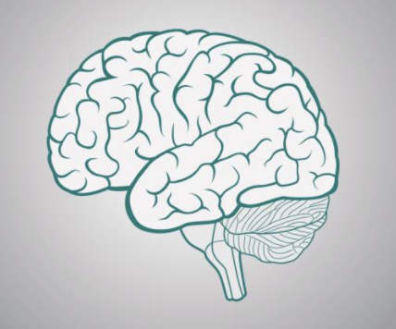

Alzheimer’s Disease (AD)
A Global Health Challenge
Current Diagnosis Approaches
Progressive
Degenerative Irreversible
Screening test
Interview
MRI test
In 2024, over 55 million people worldwide had Alzheimer's disease, which costs over $13,00 billion for the managed healthcare system.
About 1/9 people aged 65 and older have Alzheimer’s.
Intrusive and labor-intensive
About 75% undiagnosed worldwide

Slide 3


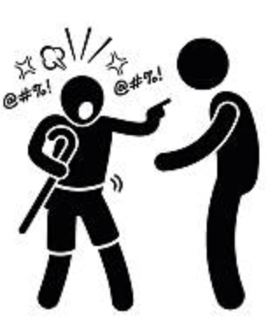
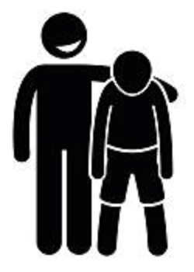
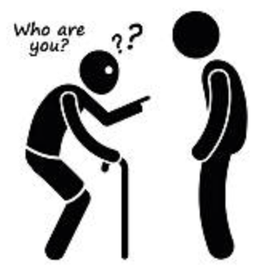
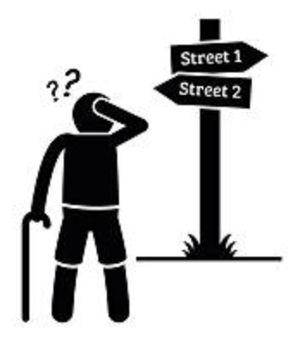

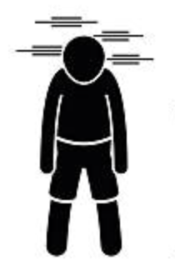


Digital Biomarkers for Early AD Diagnosis
Leverage AI and sensor devices to capture physiological, behavioral and lifestyle symptoms of AD in natural living environments.
Behavioral and Psychological Symptoms of Dementia (BPSD)
Social Interaction
Activities of Daily Living
Cognition
Multi-dimensional
Complex and dynamic
Need multiple sensor modalities

Slide 4
ADMarker: System Overview
An end-to-end system that integrates multi-modal sensors and new federated learning systems for detecting multi-dimensional AD digital biomarkers in home environments.

Slide 5
Hardware and Deployment
Multi-modal hardware systems
Clinical deployment
Participants (N=91): 31 AD, 30 mild cognitive impairment, 30 cognitively normal
61-93 (average 76.1) years old
43 females and 48 males
Deployment: four weeks
Sensing + Computing + Communication
Examples of recorded data

Slide 6
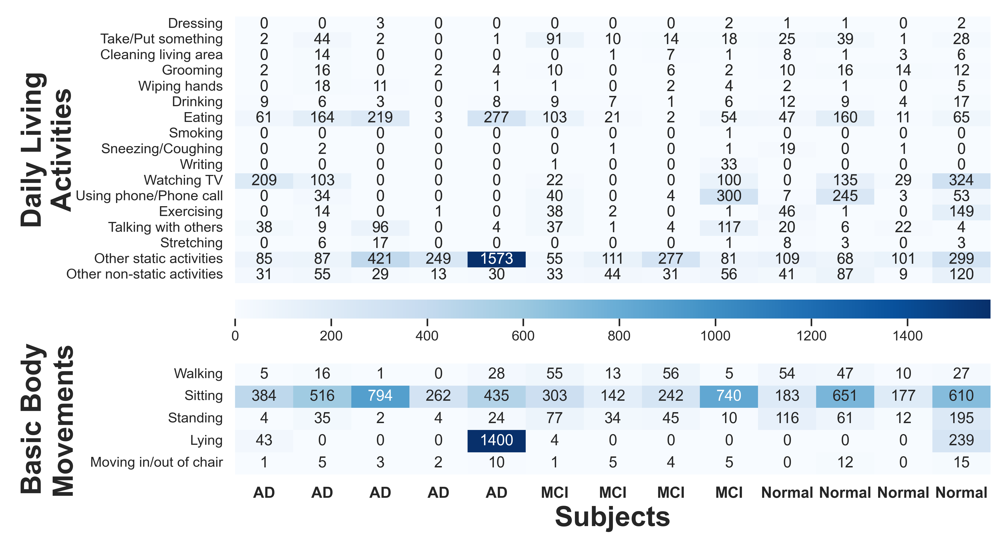
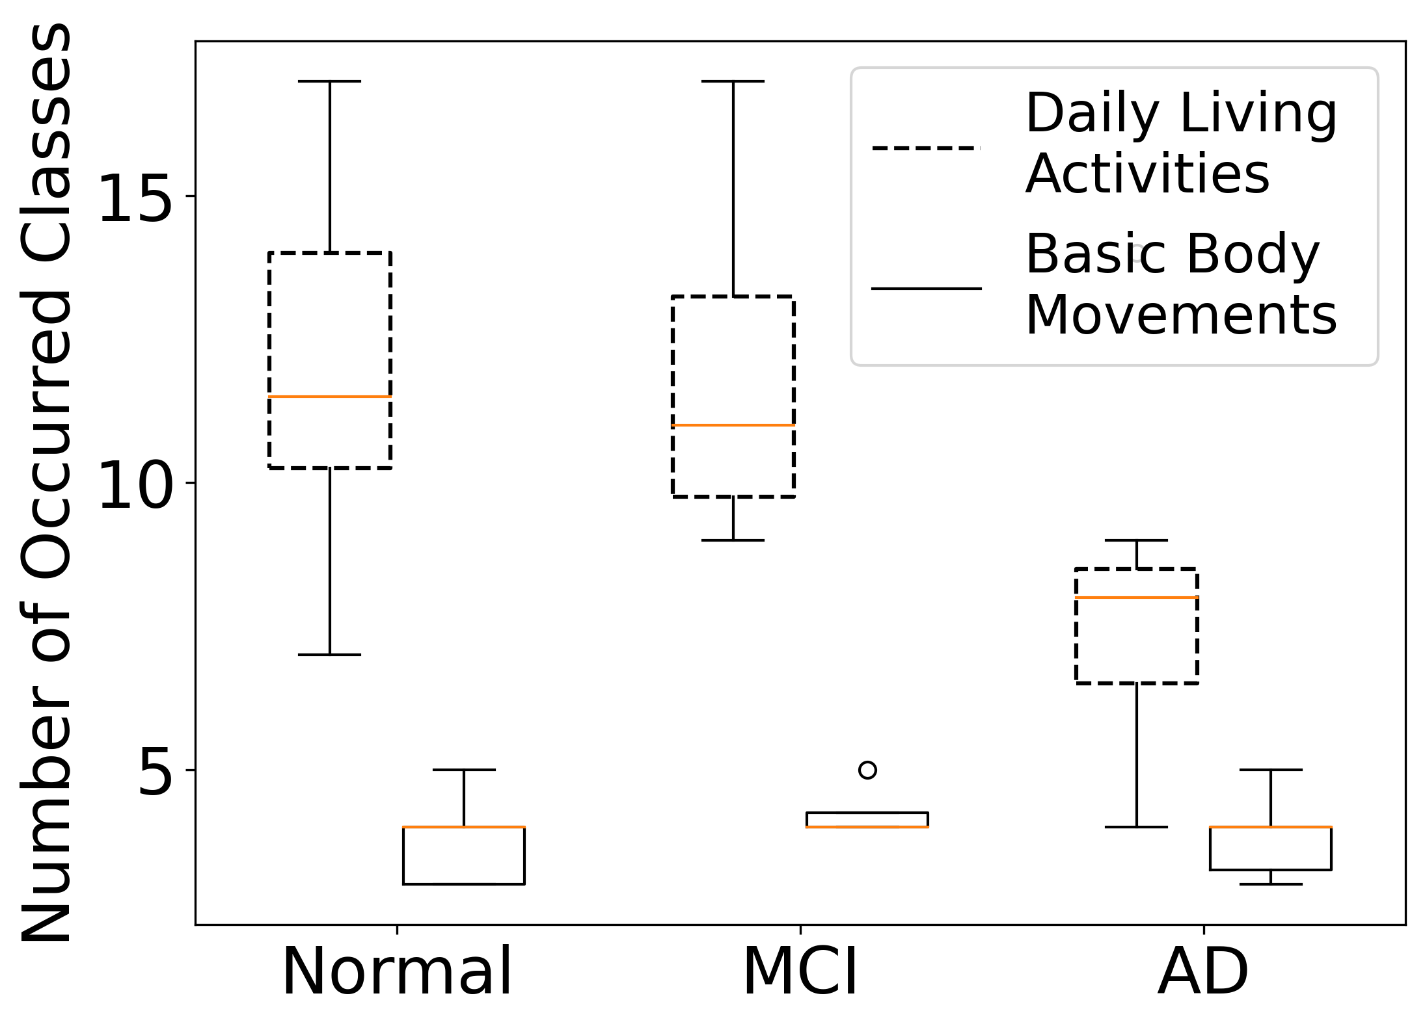
Characteristics of Behavior Biomarkers
Activity distribution of different subjects
Diversity of activities
AD subjects: perform fewer types of activities
Over 20 behavior biomarkers
Various distributions among AD, MCI and normal subjects

Slide 7
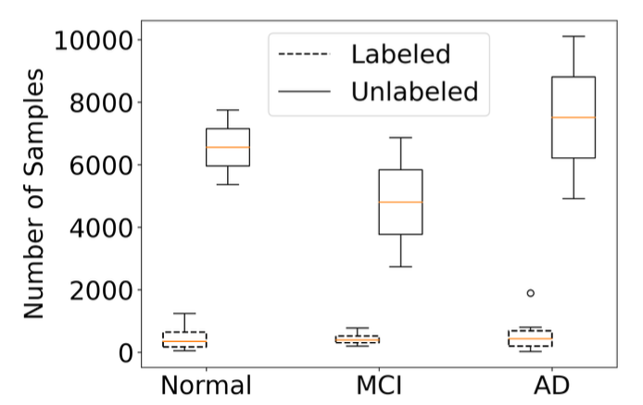
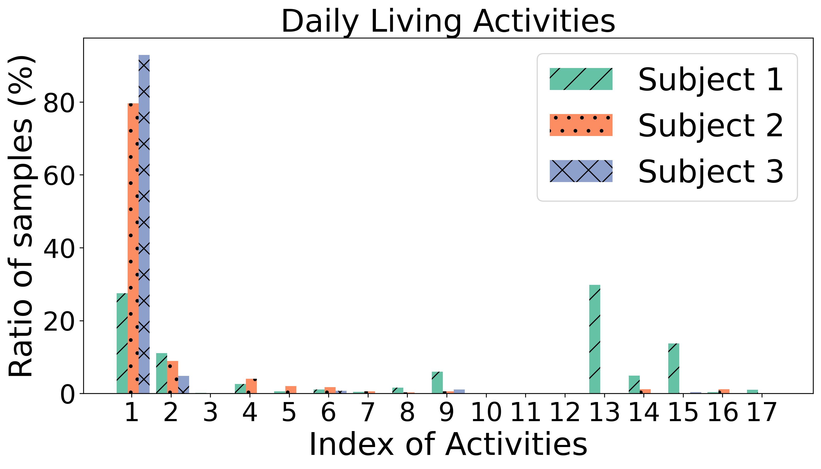
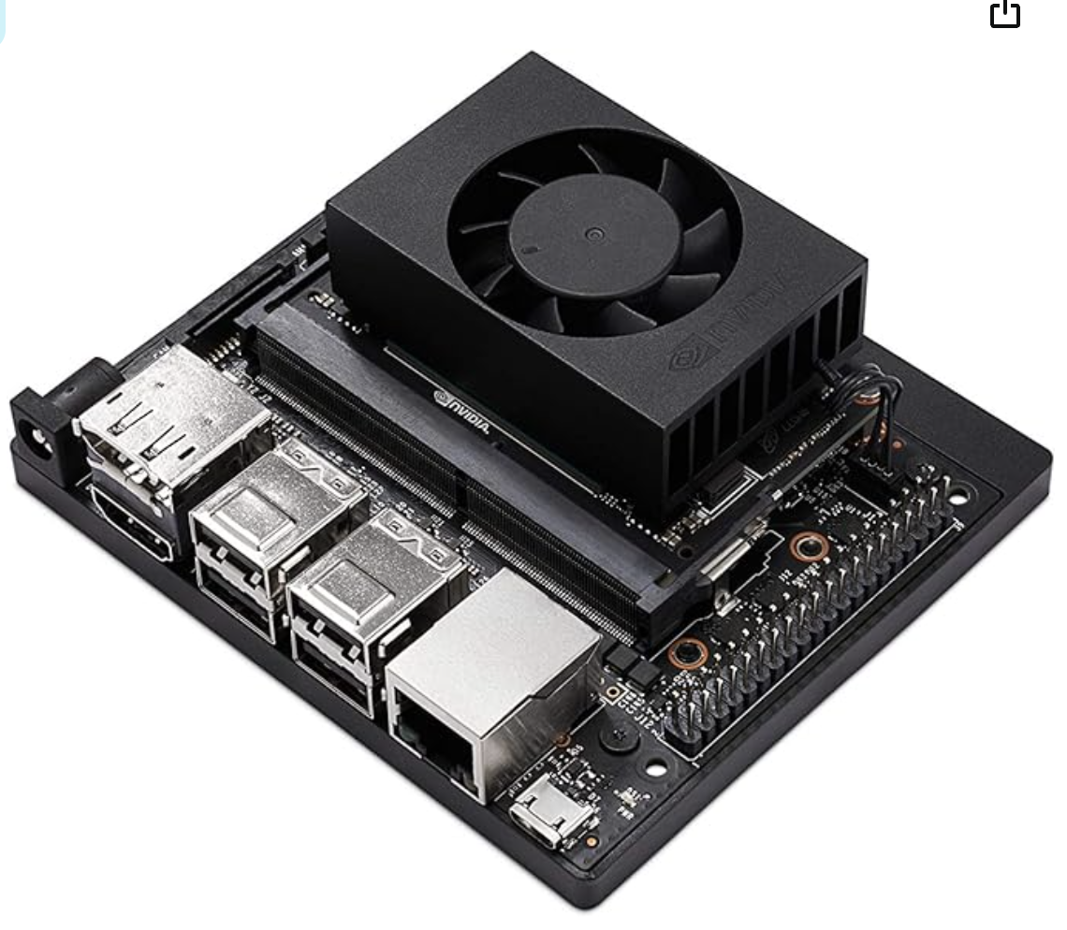
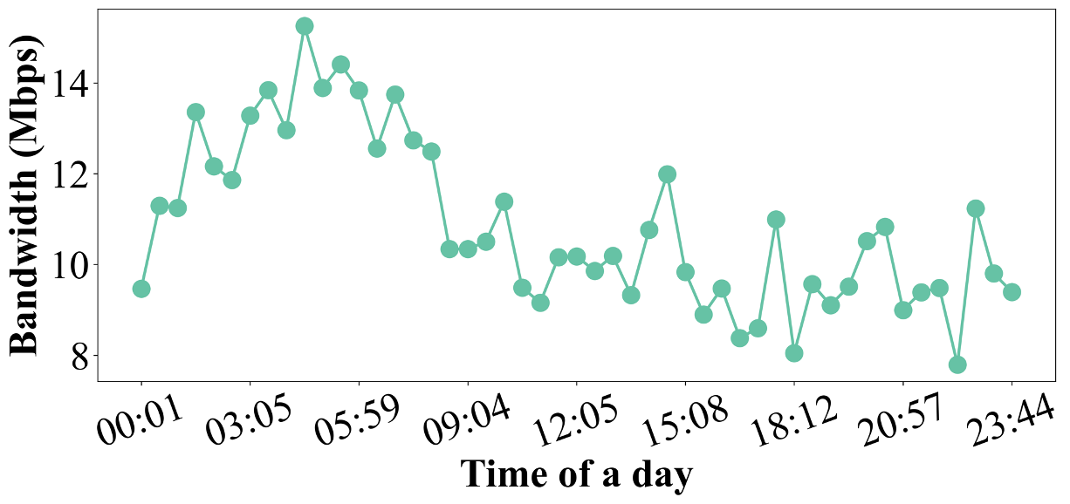
Understanding Real-World Challenges
Data Challenges
Limited labeled data
Fusing heterogeneous modalities
Non-i.i.d. distributions
System Challenges
Scalability
Sensor dynamics
Limited resources

Slide 8
Federated Learning for Biomarker Detection
A three-stage multi-modal FL framework

Slide 9
Model Training after Deployment
Training with Unlabeled Data
Training with Weak Labels
Heterogenous sensor modalities
Sparse activity logs
Contrastive fusion learning
Decompose to fine-grained labels and mapping with collected sensor data

Slide 10
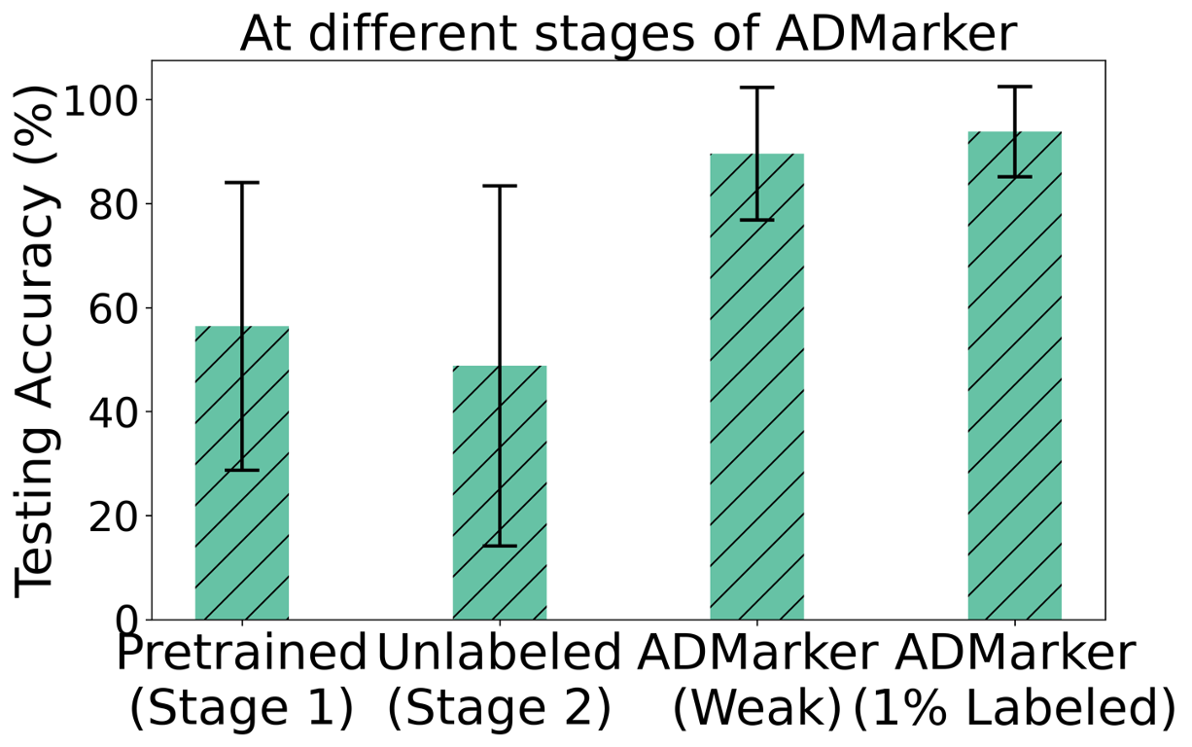
Results in Current Deployments
Biomarker detection
AD diagnosis
Over 90% accuracy
About 88.9% accuracy in identifying early AD

Slide 11
Results in Current Deployments
Effectiveness of integrating multi-dimensional biomarkers
Single-modality and a few biomarkers are not effective enough

Slide 12
Results in Current Deployments
Critical digital biomarkers for different diagnosis tasks
Non-AD/AD | Normal/MCI/AD
Standing Walking Phone Call Exercising Eating Rubbing Hands Dressing (Clothes/Shoes) | Standing Walking Exercising Moving in/out of chairs
To medical research: study the progression and intervention of AD
To engineering research: improve the efficiency of system

Slide 13

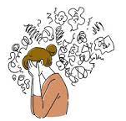
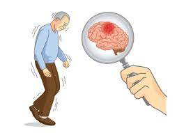


Conclusion
ADMarker: The first end-to-end system for monitoring digital biomarkers of AD
A new three-stage multi-modal FL framework to tackle challenges of biomarker detection
Clinical deployments on 91 elderly participants via Interdisciplinary collaborations
Future work
Long-term management and interventions
Apply to other medical conditions
monitor

Slide 14
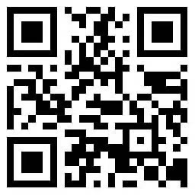


Thanks!
ADMarker: A Multi-Modal Federated Learning System for Monitoring Digital Biomarkers of Alzheimer’s Disease
Xiaomin Ouyang, Xian Shuai, Yang Li, Li Pan, Xifan Zhang, Heming Fu, Sitong Cheng, Xinyan Wang, Shihua Cao, Jiang Xin, Hazel Mok, Zhenyu Yan, Doris Sau Fung Yu, Timothy Kwok, Guoliang Xing.
https://github.com/xmouyang/ADMarker
Visit CUHK AIoT Lab

Slide 15
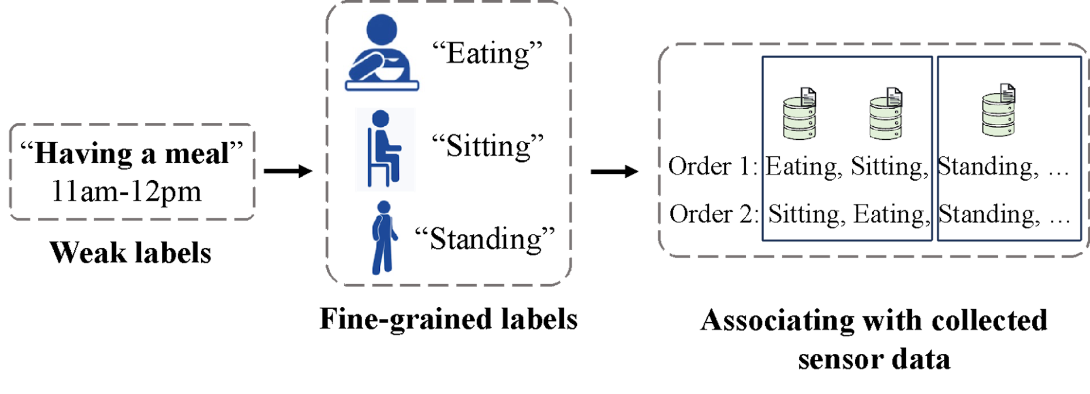
Model Training after Deployment
Training with Unlabeled Data
Training with Weak Labels
Heterogenous sensor modalities
Sparse activity logs
Contrastive fusion learning
Decompose to fine-grained labels and mapping with collected sensor data

